Slide 1
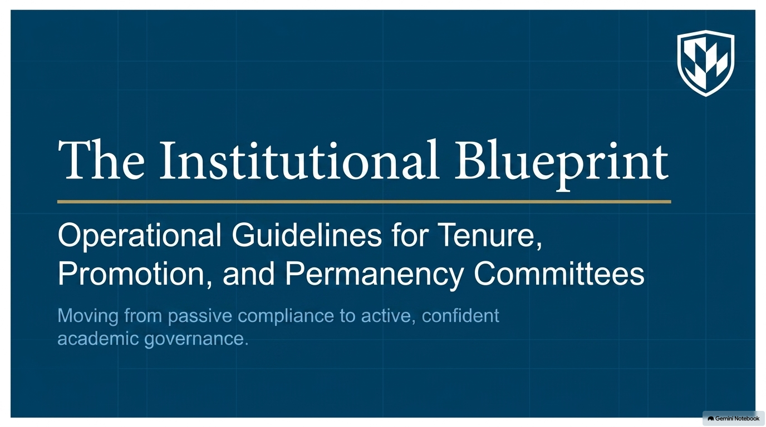
Notes:
Shelley – Open with Land Acknowledgement
With gratitude and reciprocity, Mount Royal acknowledges the relationships to the land and all beings, and the songs, stories and teachings of the Siksika Nation, Piikani Nation and Kainai Nation of the Blackfoot Confederacy, the Tsuut’ina Nation, the Chiniki, Bearspaw and Goodstoney Nations of the Iethka Stoney Nakoda, and the Métis.
Slide 1 5 min Shelley
Slide 2 2 min Shelley
Slide 3 3 min Shelley
Slide 4 5 min Mary-Lee
Slide 5 5 min Mary-Lee
Slide 6 10 min Mary-Lee
Slide 7 10 min Mary-Lee
Slide 8 10 min Mary-Lee
Slide 9 10 min Mary-Lee
Slide 10 5 min Shelley
Slide 11 5 min Shelley
Slide 12 5 min Shelley
Slide 13 5 min Shelley
Total = 80 min.

Slide 2
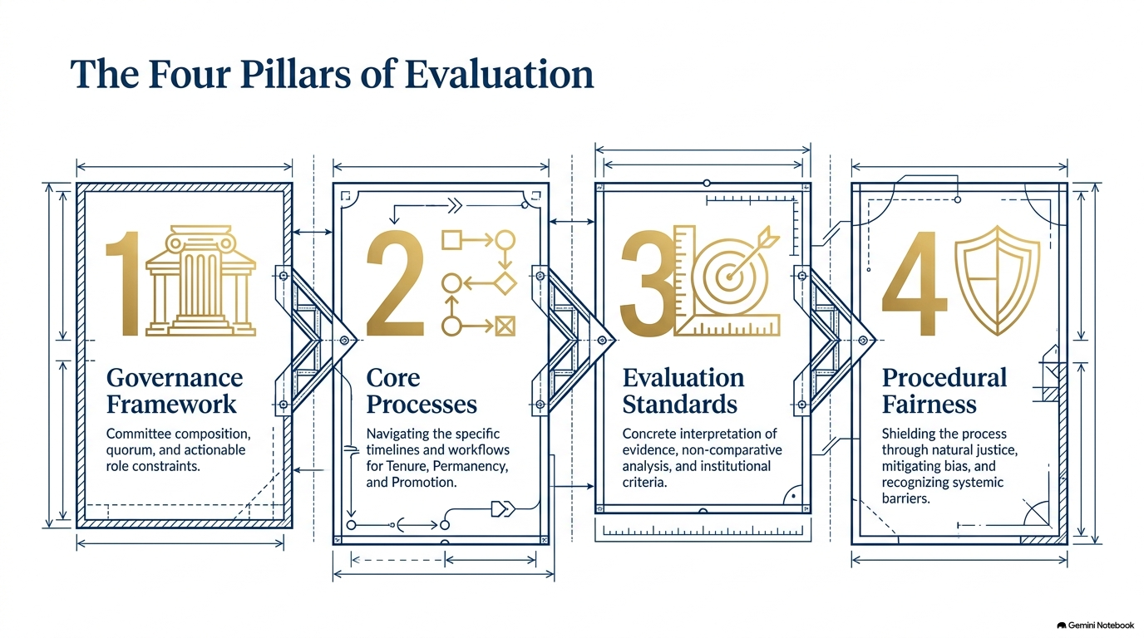
Notes:
Shelley – 5 min
Review slides
Ask if we are missing anything that the attendees want us to cover.,

Slide 3
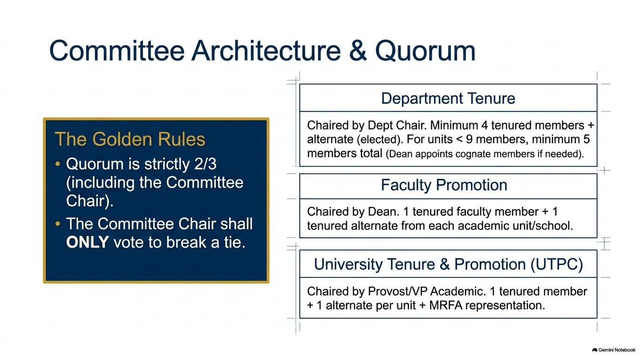
Notes:
Shelley – 3 minutes
Review slide

Slide 4
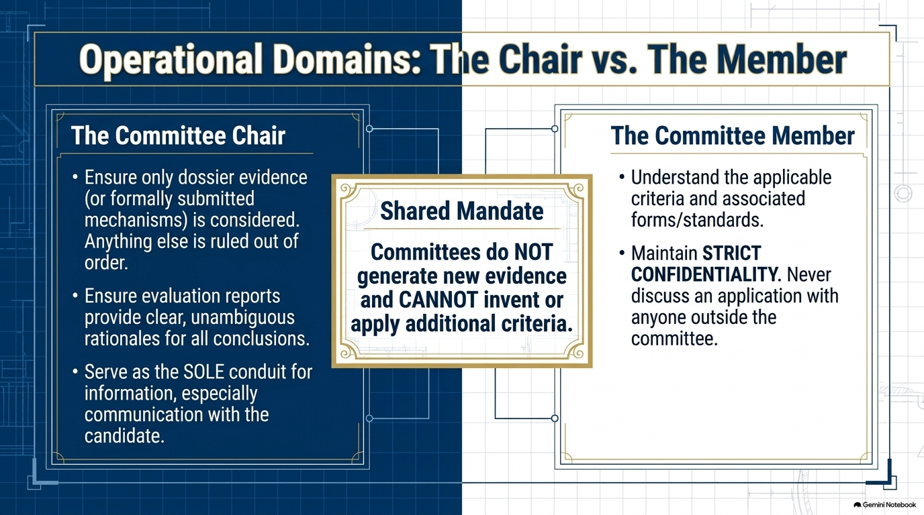
Notes:
Mary-Lee – 5 minutes
Emphasize Shared Mandate and Strict Confidentiality

Slide 5
Core Processes Matrix: Milestones & Mechanics
Pathway | Timeline & Workflow | Target and Evidence | Final Authority
To Tenure | 5-Year Process Yrs 1 & 2: Formative Yr 3: Mid-term review Yr 4: No Committee reviews Yr 5: Final Evaluation | Dossier due first Tuesday in September Form 122 due February 1 | UTPC recommends to President (grant, extend 1 yr, release)
To Permanency (Sr. Lecturers & Lab Instructors) | No later than October 15 of 2nd year the TC provides SL with a written evaluation report Apply by May 15 of Second Year Reviewed by June 1 Advised by June 21 | 2 year probation Dossier via D2L (no template) | Committee recommends to Dean (grant, extend 1 yr, release) Lab Instructors have a different committee process
Promotion to Full Professor | Dept. Chair comments on conduct only. External referees review dossier Faculty PC prepares recommendation | Sustained excellence. Dossier via Google Drive Candidate suggest external Referees | UTPC makes final decision (grant or deny)
Notes:
Mary Lee – 5 min

Slide 6
Tenure Committee Evaluation Workflow
A structured process for reviewing dossiers, deliberating, and selecting assessment categories
PHASE 1
Dossier Review & Assessment
• Reading the Dossier
Thoroughly review all candidate-compiled evidence and materials in the Google Drive dossier.
• Applying the Criteria
Assess performance solely against approved institutional and faculty criteria. Do not invent criteria.
PHASE 2
Committee Deliberation
• Meeting to Discuss
Convene as a committee to discuss findings. Maintain strict confidentiality throughout.
• Division of Labour
Allocate report writing responsibilities among committee members.
• Tone of the Report
Ensure a professional tone. Keep report binary (meets/does not meet) and provide clear rationales.
PHASE 3
Form Outcomes (113/114)
• Assessment Level Selection
Evaluate progress and select one of three contract assessment outcomes:
- Does Not Demonstrate Assistant
Candidate does not demonstrate Assistant level performance.
- Assistant Level Only
Candidate is performing at the Assistant level only.
- Assistant & Clear Progress
Assistant level with clear progress to Associate or promise of tenure.
Notes:
Mary-Lee – 10 min

Slide 7
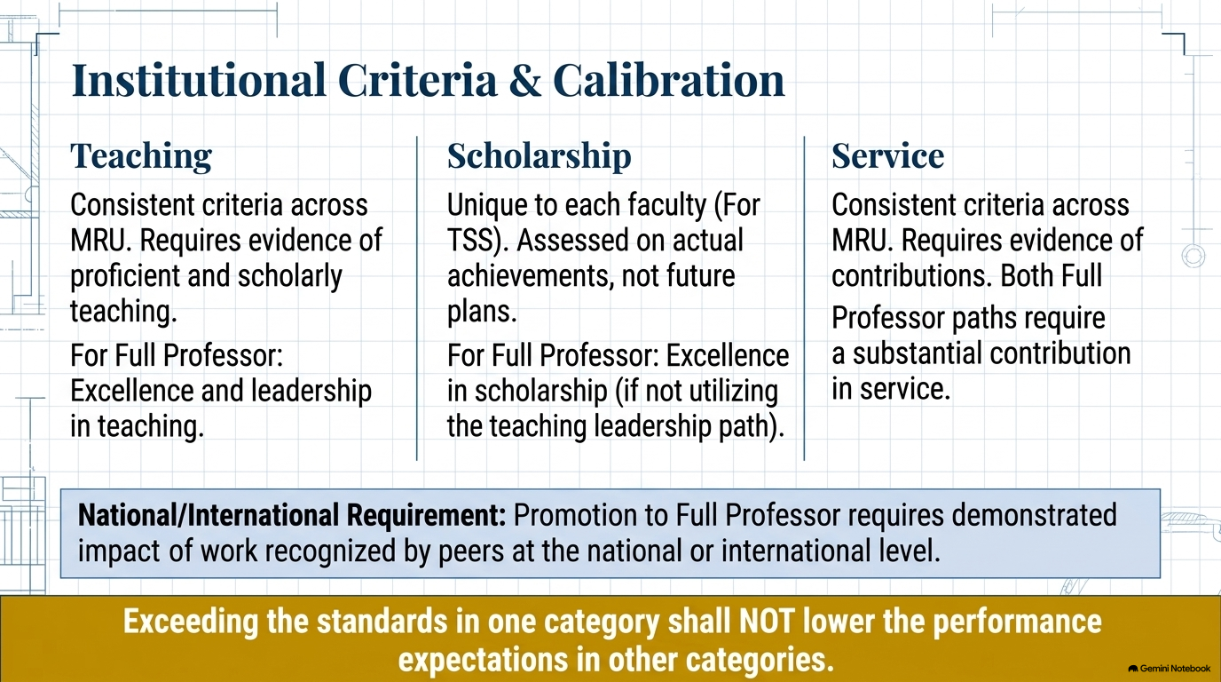
Notes:
May-Lee – 10 min
Share slide – generate conversation with attendees

Slide 8
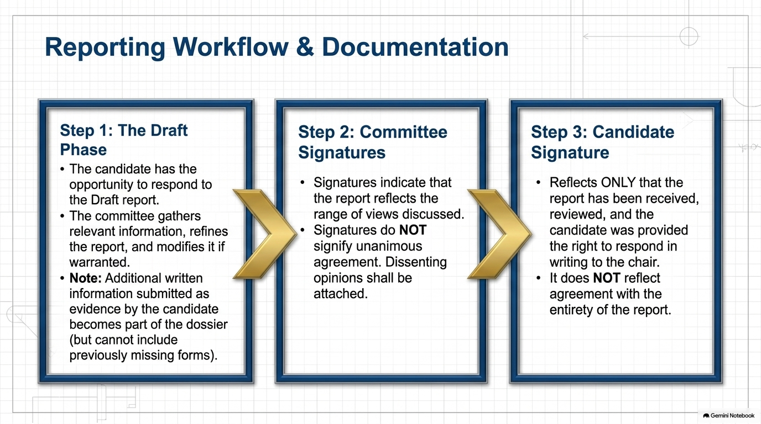
Notes:
Mary-Lee – 10 min

Slide 9
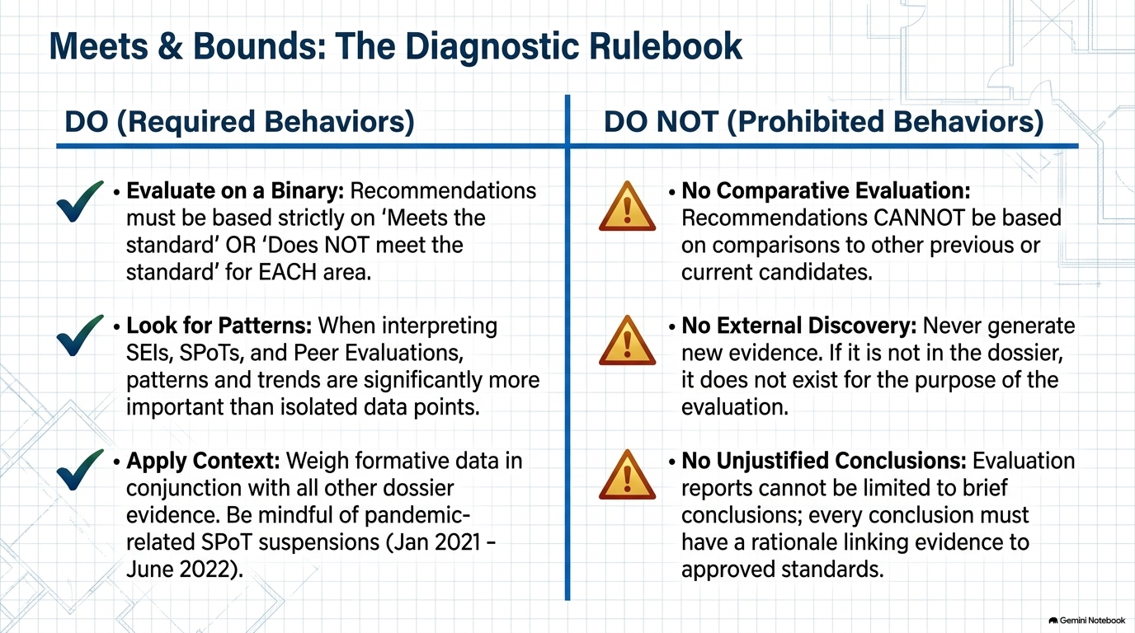
Notes:
Mary-Lee – 10 minutes
Share slide – generate conversation with attendees

Slide 10
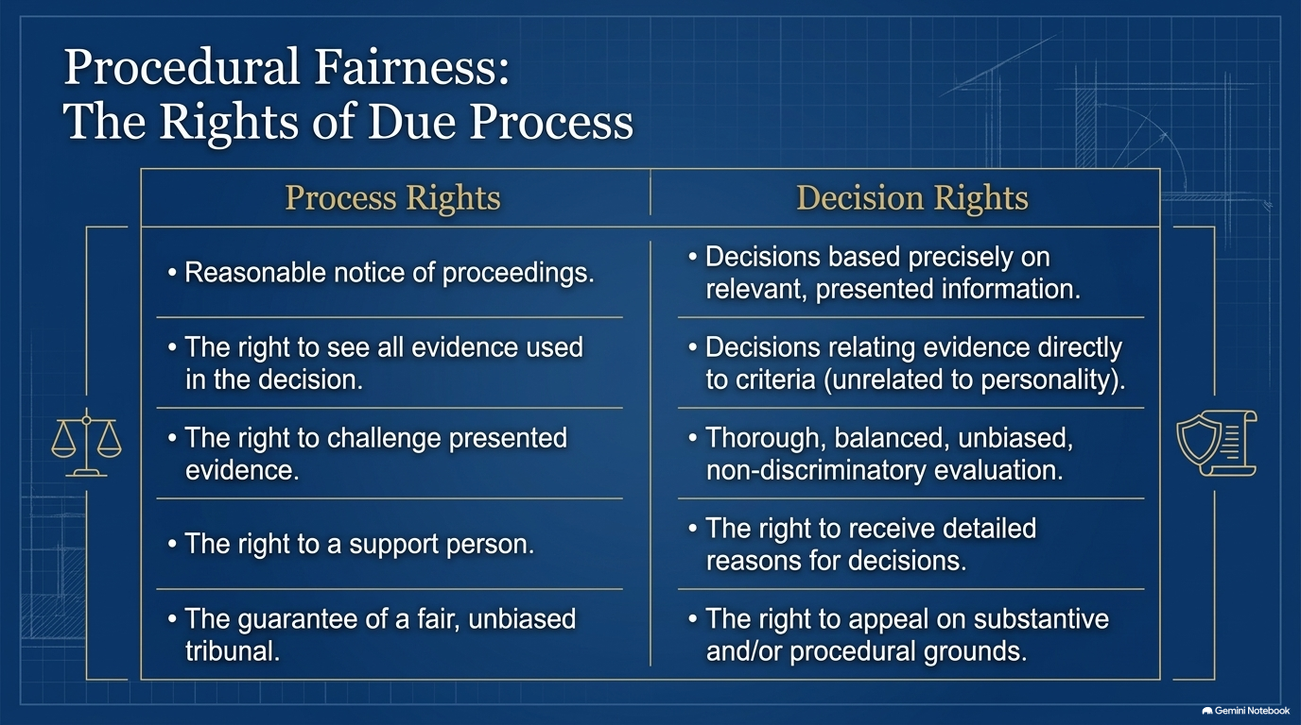
Notes:
Shelley – 5 min

Slide 11
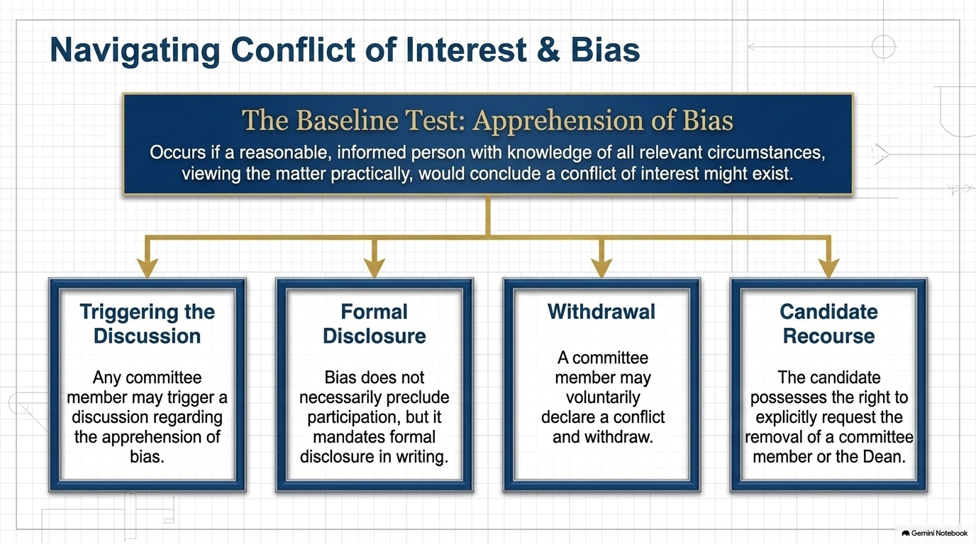
Notes:
Shelley – 5 min

Slide 12
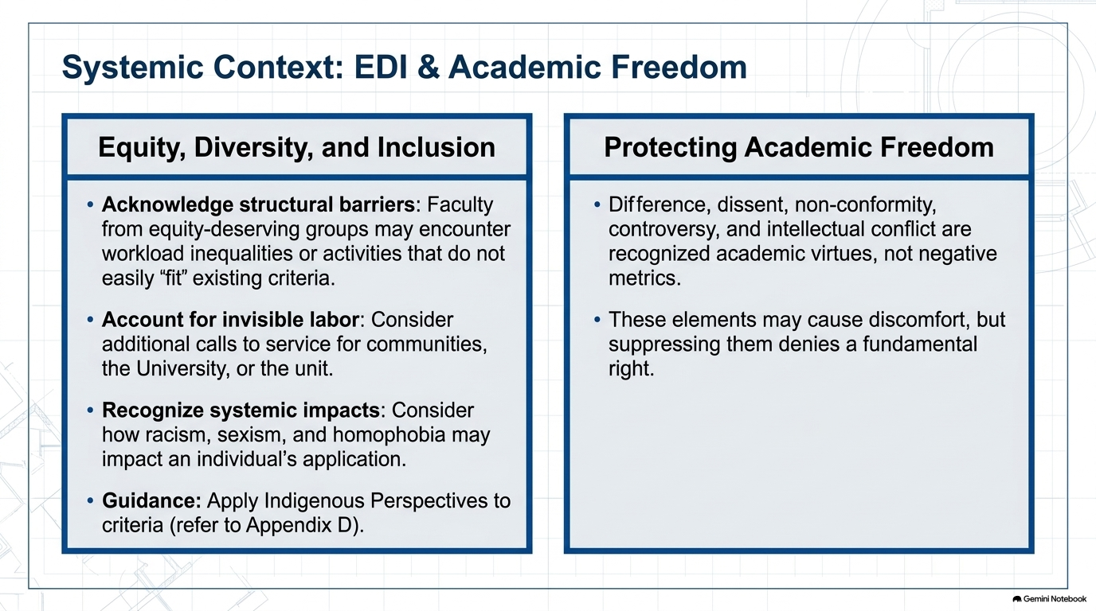
Notes:
Shelley – 5 min

Slide 13
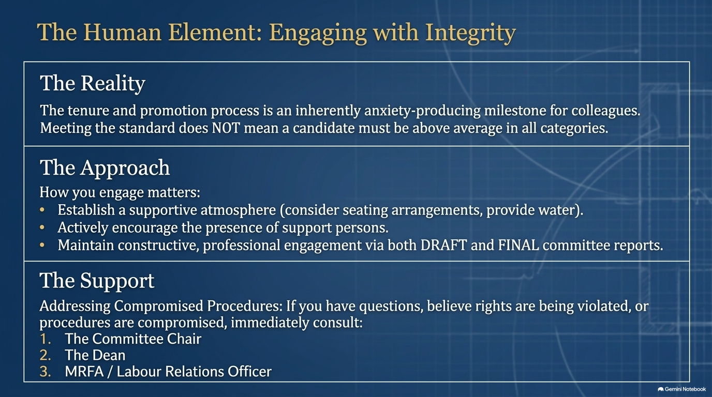
Notes:
Shelley – 5 min

